Slide 1




Trade Unions for a Fair Recovery
Cascading Grant

Slide 2
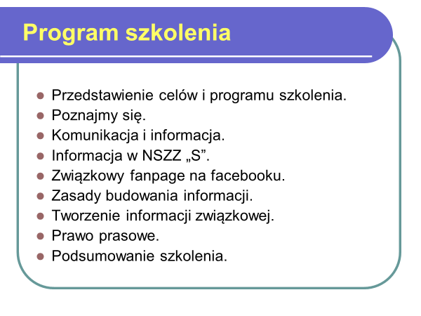
Trade Unions for a Fair Recovery
Cascading Grant

Slide 3
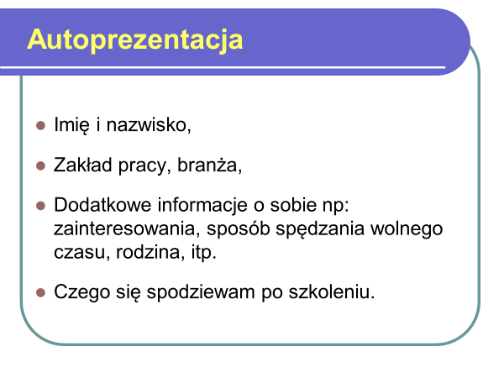
Trade Unions for a Fair Recovery
Cascading Grant

Slide 4
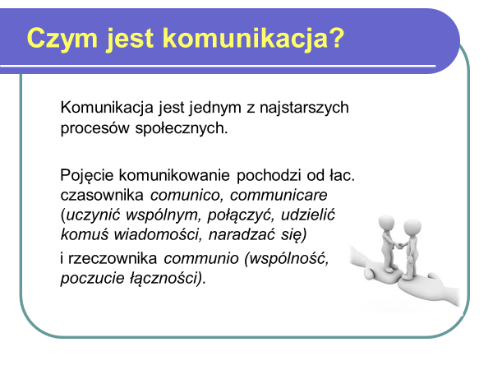
Trade Unions for a Fair Recovery
Cascading Grant

Slide 5
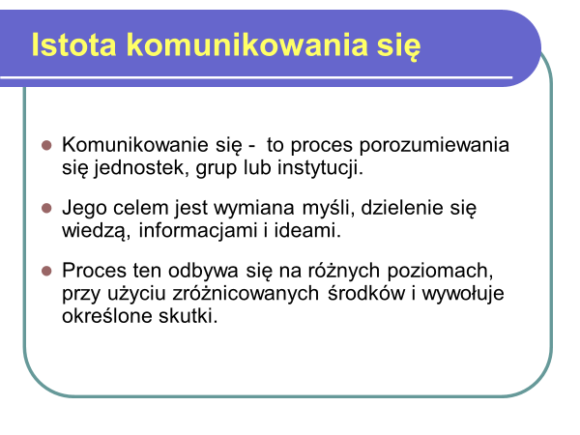
Trade Unions for a Fair Recovery
Cascading Grant

Slide 6
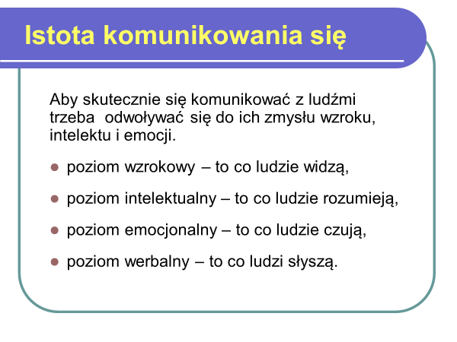
Trade Unions for a Fair Recovery
Cascading Grant

Slide 7
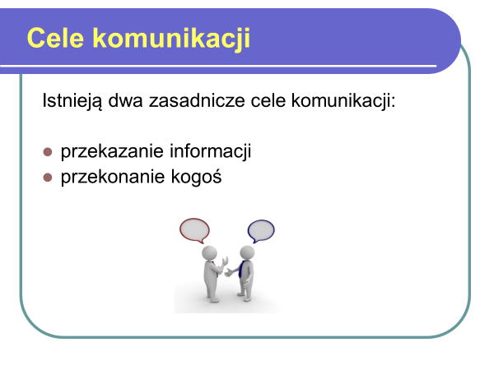
Trade Unions for a Fair Recovery
Cascading Grant

Slide 8
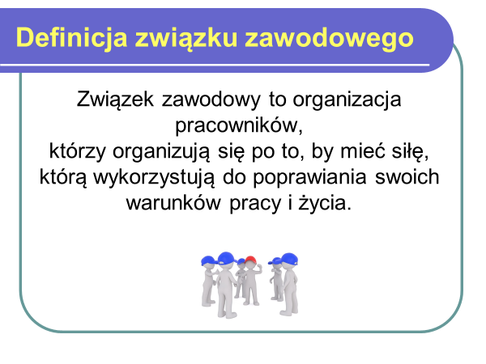
Trade Unions for a Fair Recovery
Cascading Grant

Slide 9
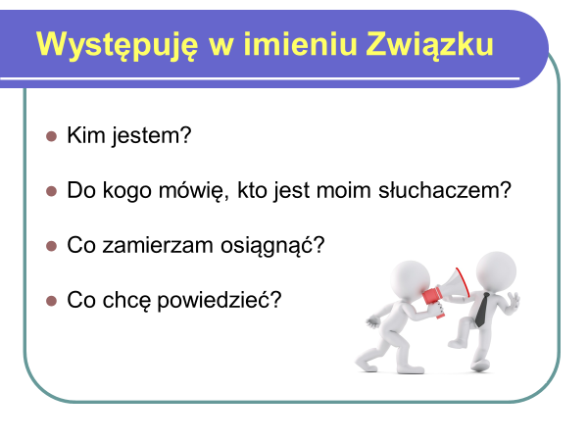
Trade Unions for a Fair Recovery
Cascading Grant

Slide 10
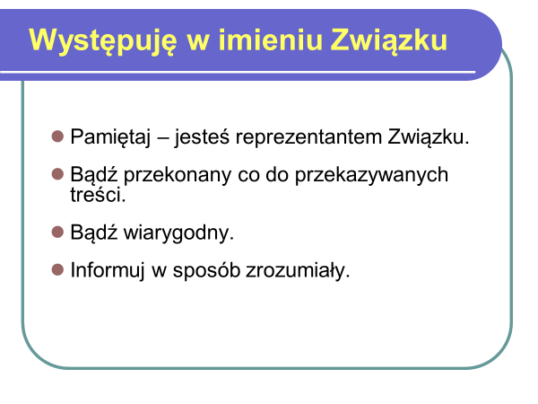
Trade Unions for a Fair Recovery
Cascading Grant

Slide 11
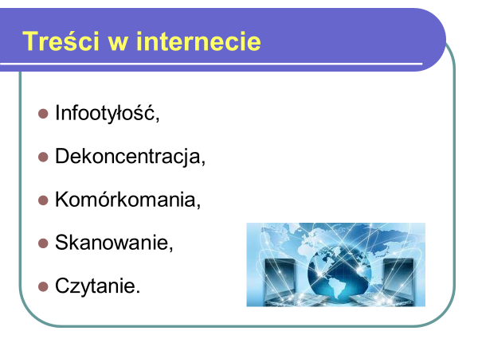
Trade Unions for a Fair Recovery
Cascading Grant

Slide 12
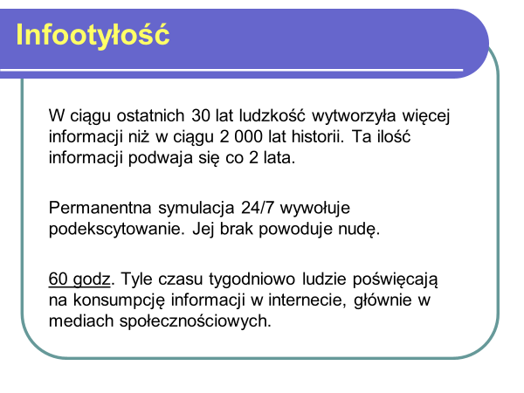
Trade Unions for a Fair Recovery
Cascading Grant

Slide 13
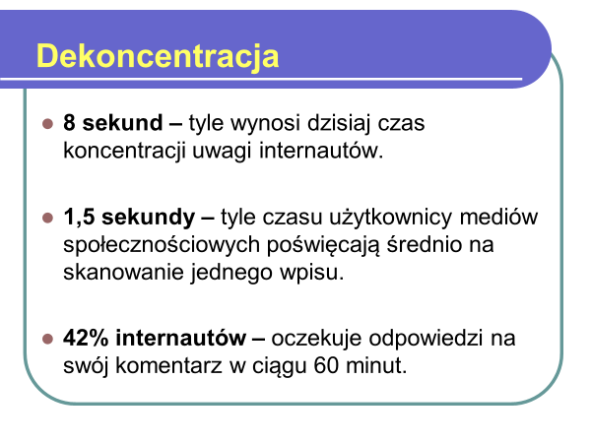
Trade Unions for a Fair Recovery
Cascading Grant

Slide 14
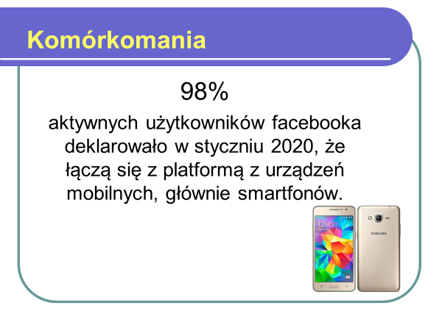
Trade Unions for a Fair Recovery
Cascading Grant

Slide 15
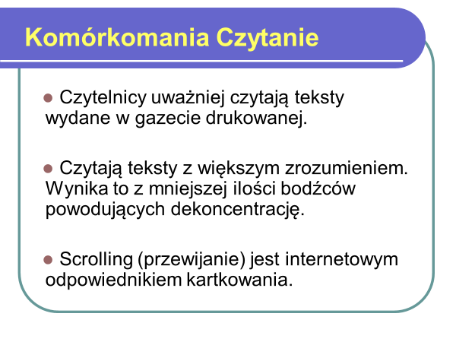
Trade Unions for a Fair Recovery
Cascading Grant

Slide 16
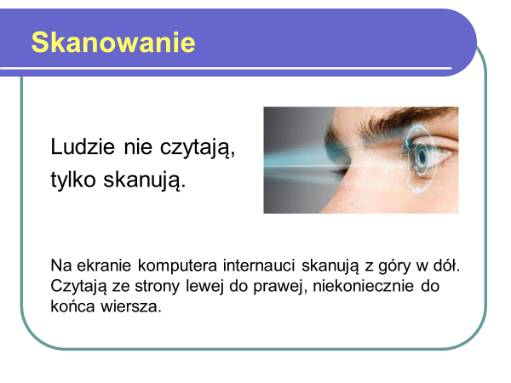
Trade Unions for a Fair Recovery
Cascading Grant

Slide 17
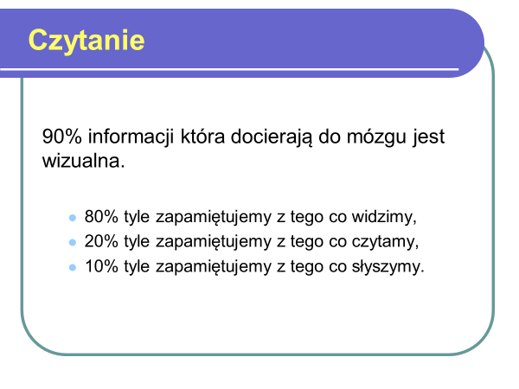
Trade Unions for a Fair Recovery
Cascading Grant

Slide 18
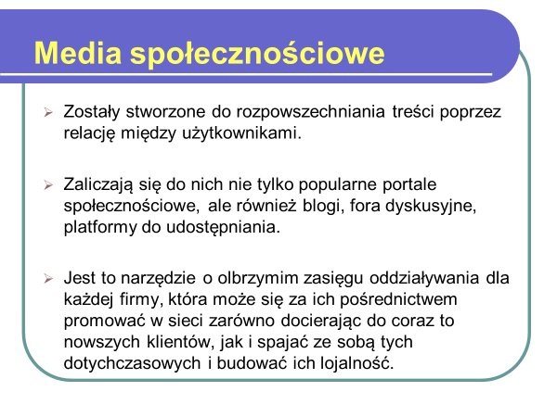
Trade Unions for a Fair Recovery
Cascading Grant

Slide 19
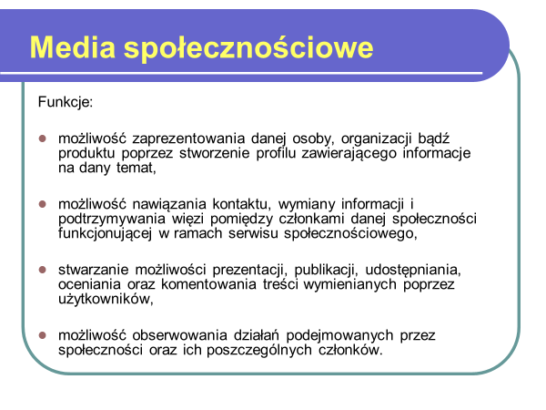
Trade Unions for a Fair Recovery
Cascading Grant

Slide 20
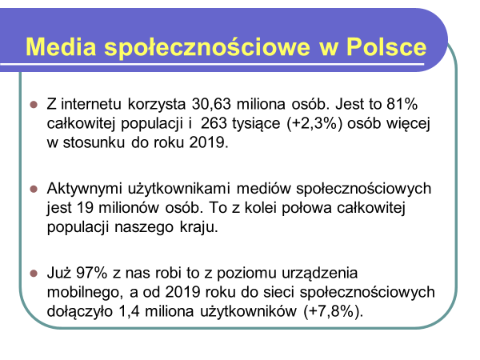
Trade Unions for a Fair Recovery
Cascading Grant

Slide 21

Trade Unions for a Fair Recovery
Cascading Grant

Slide 22
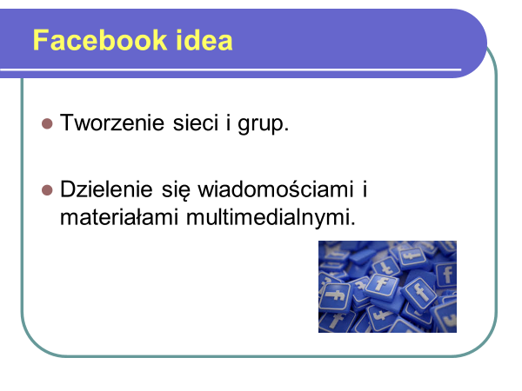
Trade Unions for a Fair Recovery
Cascading Grant

Slide 23
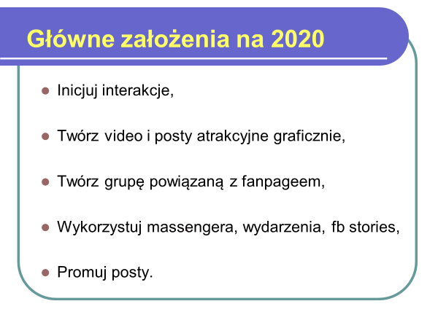
Trade Unions for a Fair Recovery
Cascading Grant

Slide 24
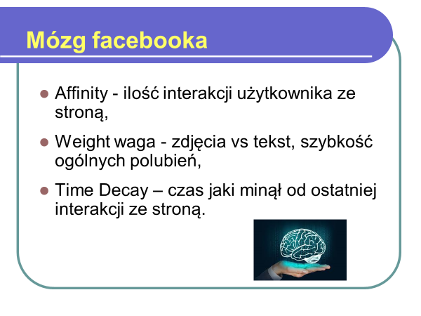
Trade Unions for a Fair Recovery
Cascading Grant

Slide 25
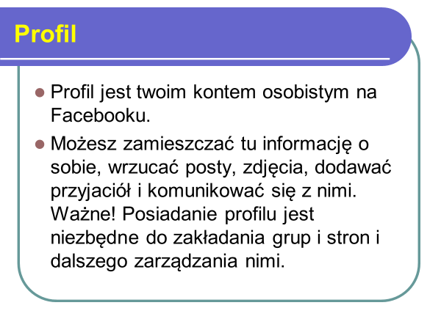
Trade Unions for a Fair Recovery
Cascading Grant

Slide 26
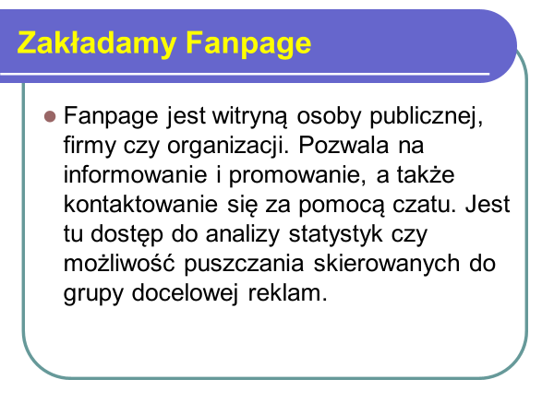
Trade Unions for a Fair Recovery
Cascading Grant

Slide 27
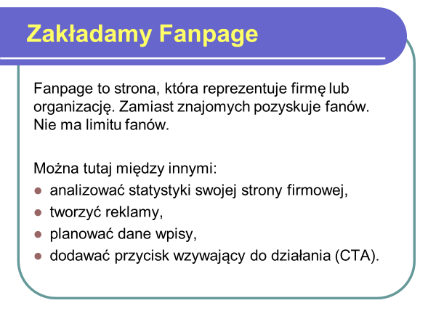
Trade Unions for a Fair Recovery
Cascading Grant

Slide 28
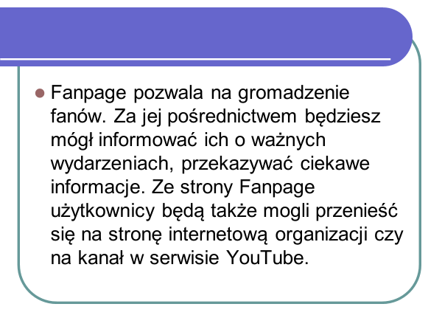
Trade Unions for a Fair Recovery
Cascading Grant

Slide 29
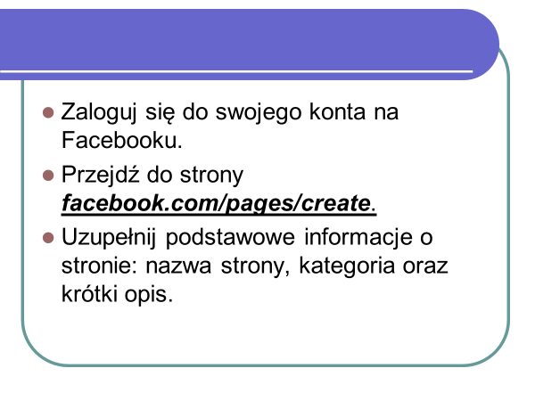
Trade Unions for a Fair Recovery
Cascading Grant

Slide 30

Trade Unions for a Fair Recovery
Cascading Grant

Slide 31
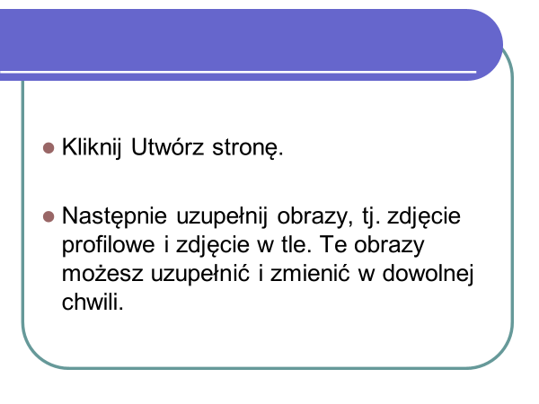
Trade Unions for a Fair Recovery
Cascading Grant

Slide 32
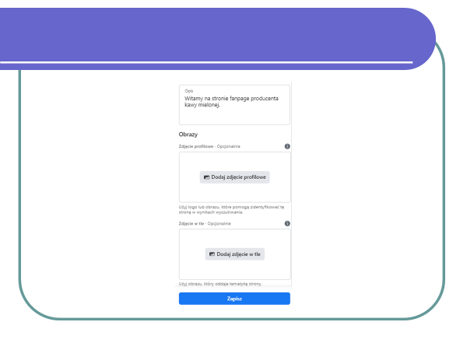
Trade Unions for a Fair Recovery
Cascading Grant

Slide 33
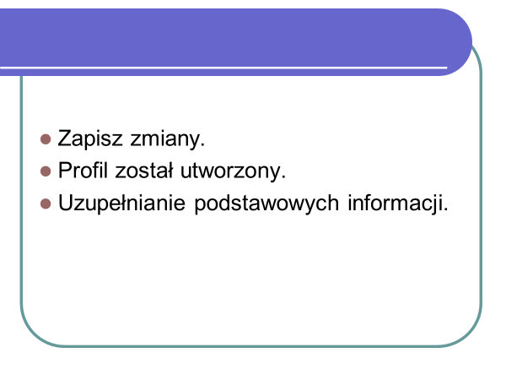
Trade Unions for a Fair Recovery
Cascading Grant

Slide 34

Trade Unions for a Fair Recovery
Cascading Grant

Slide 35
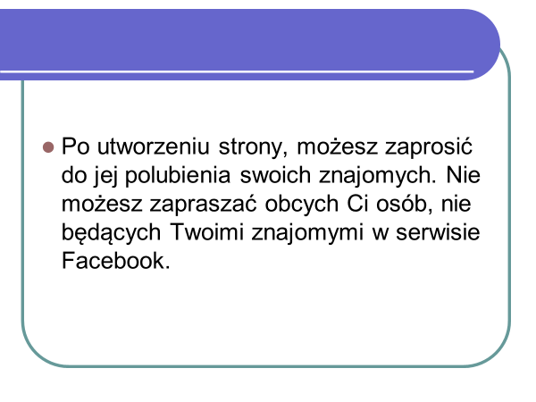
Trade Unions for a Fair Recovery
Cascading Grant

Slide 36
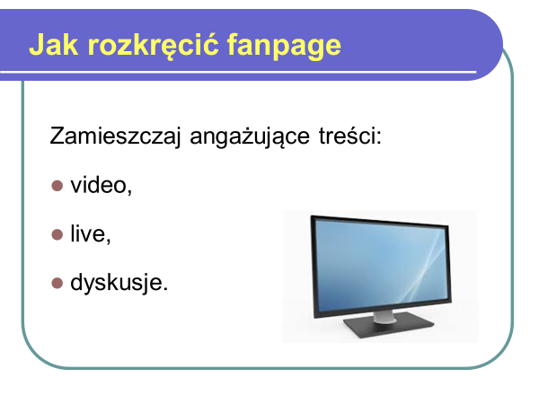
Trade Unions for a Fair Recovery
Cascading Grant

Slide 37

Trade Unions for a Fair Recovery
Cascading Grant

Slide 38
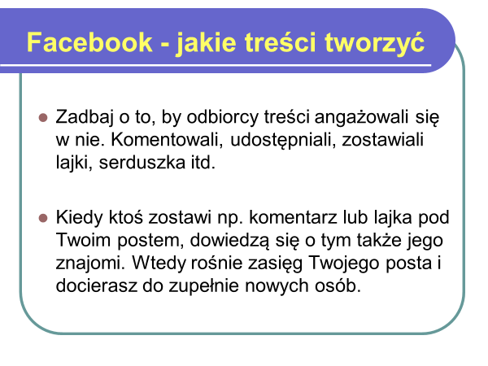
Trade Unions for a Fair Recovery
Cascading Grant

Slide 39
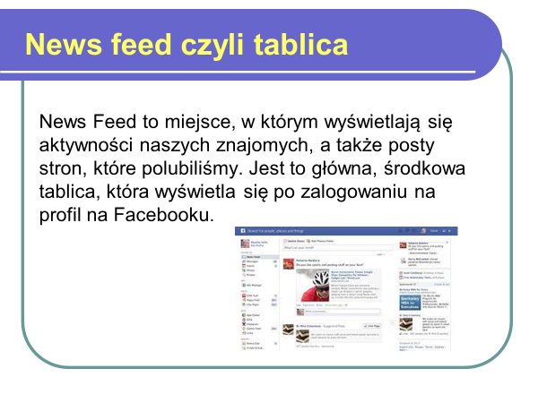
Trade Unions for a Fair Recovery
Cascading Grant

Slide 40

Trade Unions for a Fair Recovery
Cascading Grant

Slide 41
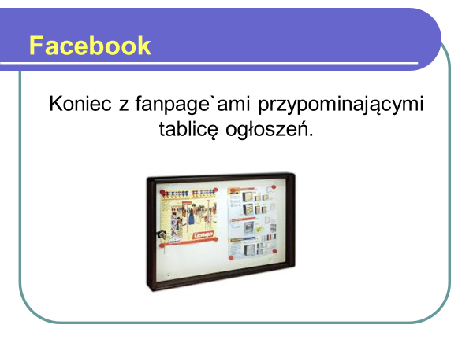
Trade Unions for a Fair Recovery
Cascading Grant

Slide 42
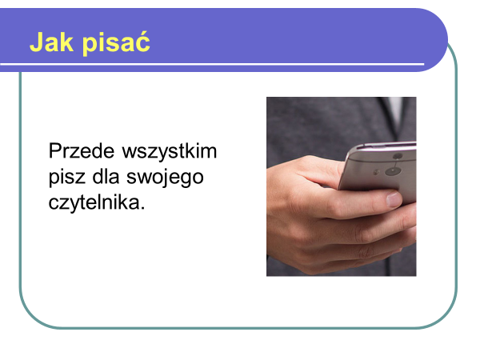
Trade Unions for a Fair Recovery
Cascading Grant

Slide 43
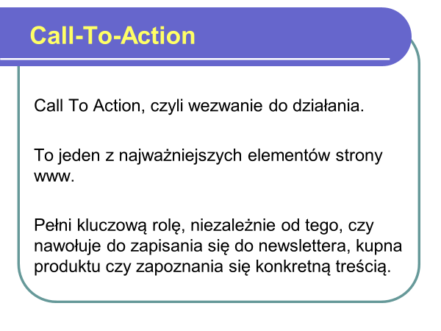
Trade Unions for a Fair Recovery
Cascading Grant

Slide 44
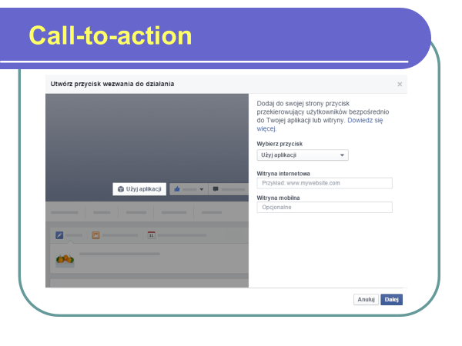
Trade Unions for a Fair Recovery
Cascading Grant

Slide 45
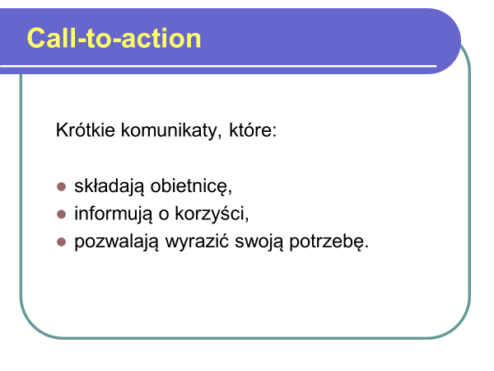
Trade Unions for a Fair Recovery
Cascading Grant

Slide 46
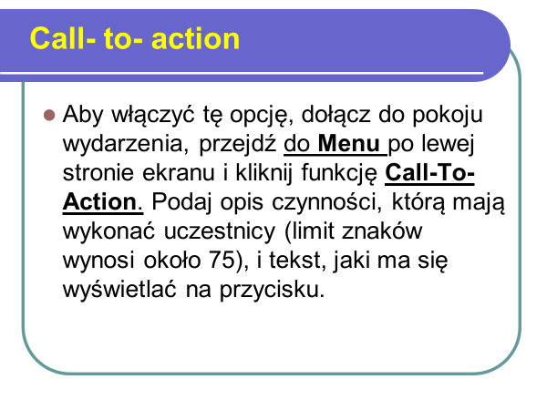
Trade Unions for a Fair Recovery
Cascading Grant

Slide 47
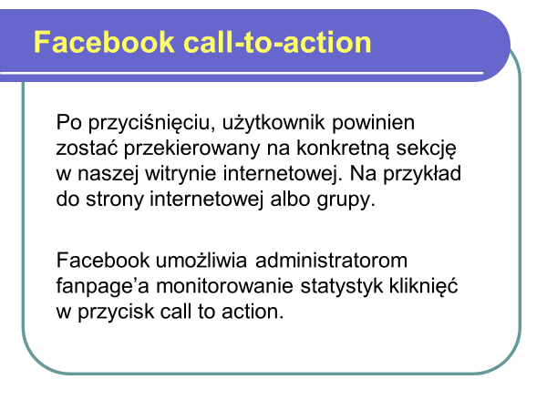
Trade Unions for a Fair Recovery
Cascading Grant

Slide 48
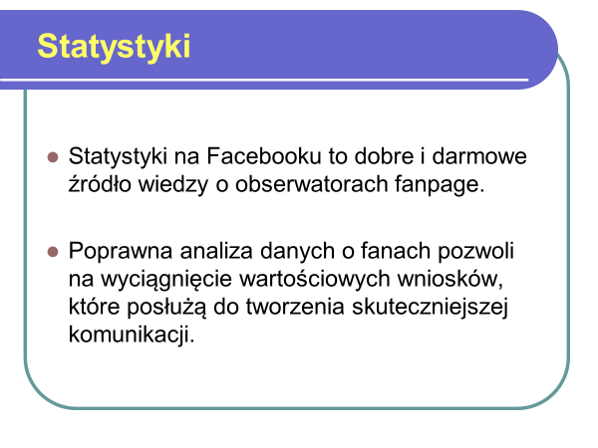
Trade Unions for a Fair Recovery
Cascading Grant

Slide 49
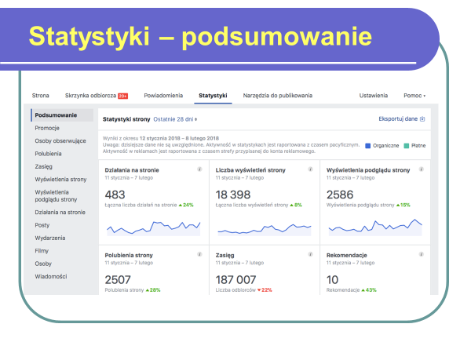
Trade Unions for a Fair Recovery
Cascading Grant

Slide 50
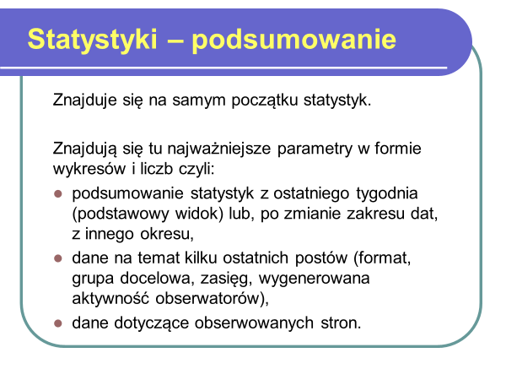
Trade Unions for a Fair Recovery
Cascading Grant

Slide 51
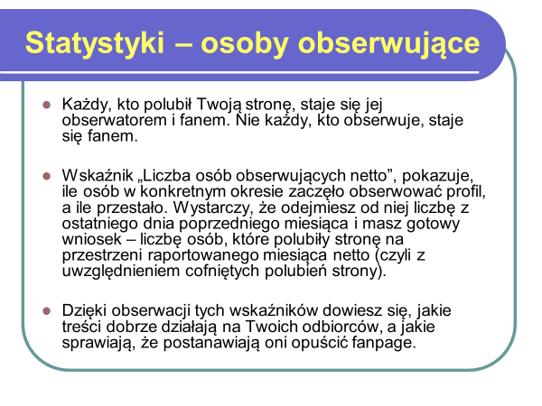
Trade Unions for a Fair Recovery
Cascading Grant

Slide 52
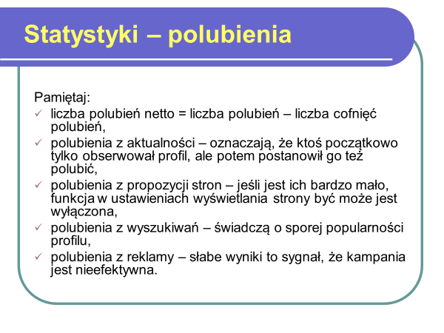
Trade Unions for a Fair Recovery
Cascading Grant

Slide 53
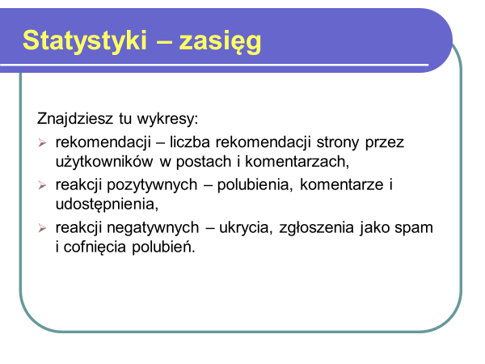
Trade Unions for a Fair Recovery
Cascading Grant

Slide 54
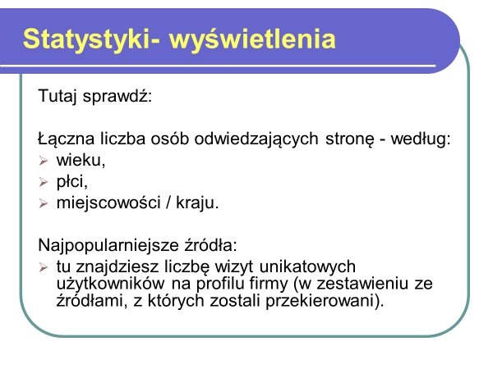
Trade Unions for a Fair Recovery
Cascading Grant

Slide 55
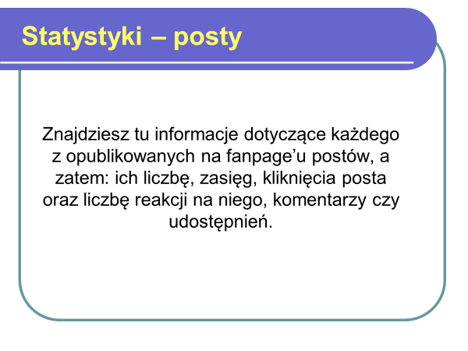
Trade Unions for a Fair Recovery
Cascading Grant

Slide 56
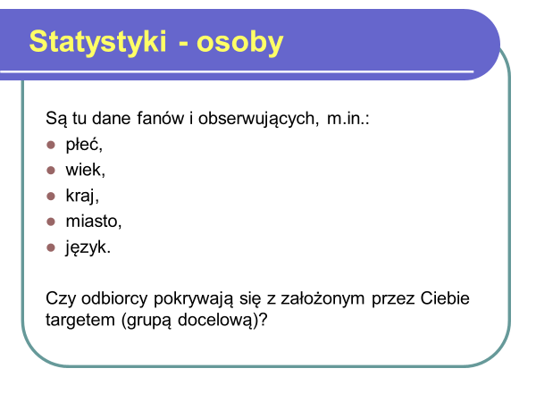
Trade Unions for a Fair Recovery
Cascading Grant

Slide 57

Trade Unions for a Fair Recovery
Cascading Grant

Slide 58

Trade Unions for a Fair Recovery
Cascading Grant

Slide 59

Trade Unions for a Fair Recovery
Cascading Grant

Slide 60

Trade Unions for a Fair Recovery
Cascading Grant

Slide 61

Trade Unions for a Fair Recovery
Cascading Grant

Slide 62

Trade Unions for a Fair Recovery
Cascading Grant

Slide 63

Trade Unions for a Fair Recovery
Cascading Grant

Slide 64

Trade Unions for a Fair Recovery
Cascading Grant

Slide 65

Trade Unions for a Fair Recovery
Cascading Grant

Slide 66

Trade Unions for a Fair Recovery
Cascading Grant

Slide 67

Trade Unions for a Fair Recovery
Cascading Grant

Slide 68

Trade Unions for a Fair Recovery
Cascading Grant

Slide 69

Trade Unions for a Fair Recovery
Cascading Grant

Slide 70

Trade Unions for a Fair Recovery
Cascading Grant

Slide 71

Trade Unions for a Fair Recovery
Cascading Grant

Slide 72

Trade Unions for a Fair Recovery
Cascading Grant

Slide 73

Trade Unions for a Fair Recovery
Cascading Grant

Slide 74

Trade Unions for a Fair Recovery
Cascading Grant

Slide 75

Trade Unions for a Fair Recovery
Cascading Grant

Slide 76

Trade Unions for a Fair Recovery
Cascading Grant

Slide 77

Trade Unions for a Fair Recovery
Cascading Grant

Slide 78

Trade Unions for a Fair Recovery
Cascading Grant

Slide 79

Trade Unions for a Fair Recovery
Cascading Grant

Slide 80

Trade Unions for a Fair Recovery
Cascading Grant

Slide 81

Trade Unions for a Fair Recovery
Cascading Grant

Slide 82

Trade Unions for a Fair Recovery
Cascading Grant

Slide 83

Trade Unions for a Fair Recovery
Cascading Grant

Slide 84

Trade Unions for a Fair Recovery
Cascading Grant

Slide 85

Trade Unions for a Fair Recovery
Cascading Grant

Slide 86

Trade Unions for a Fair Recovery
Cascading Grant

Slide 87

Trade Unions for a Fair Recovery
Cascading Grant

Slide 88

Trade Unions for a Fair Recovery
Cascading Grant

Slide 89

Trade Unions for a Fair Recovery
Cascading Grant

Slide 90

Trade Unions for a Fair Recovery
Cascading Grant

Slide 91

Trade Unions for a Fair Recovery
Cascading Grant

Slide 92

Trade Unions for a Fair Recovery
Cascading Grant

Slide 93

Trade Unions for a Fair Recovery
Cascading Grant

Slide 94

Trade Unions for a Fair Recovery
Cascading Grant

Slide 95

Trade Unions for a Fair Recovery
Cascading Grant

Slide 96

Trade Unions for a Fair Recovery
Cascading Grant

